Slide 1

Data Analytics in Cyber Security (CT115-3-M) (Version E)
Machine Learning Pipeline
Module Code & Module Title
Slide Title
SLIDE 1

Slide 2
TOPIC LEARNING OUTCOMES
At the end of this topic, you should be able to:
Understand various Machine Learning terminologies
Understand the Machine Learning pipeline.
Module Code & Module Title
Slide Title
SLIDE 2

Slide 3
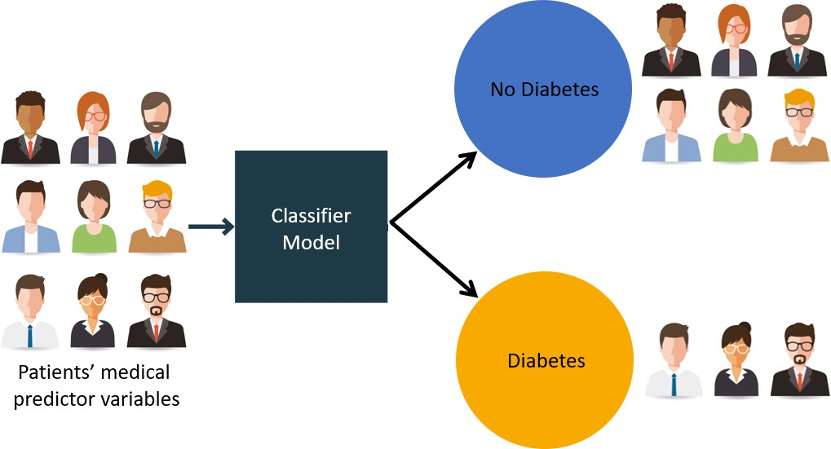
Develop A Diabetes Prediction System (DPS)
Image Source: https://jnyh.medium.com/building-a-machine-learning-classifier-model-for-diabetes-4fca624daed0

Slide 4
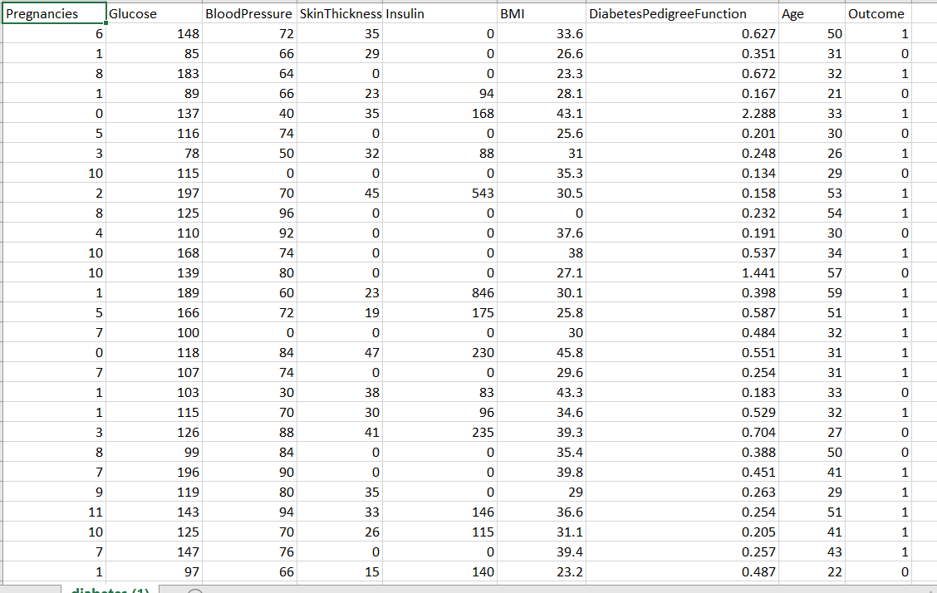
Sample Medical Data

Slide 5
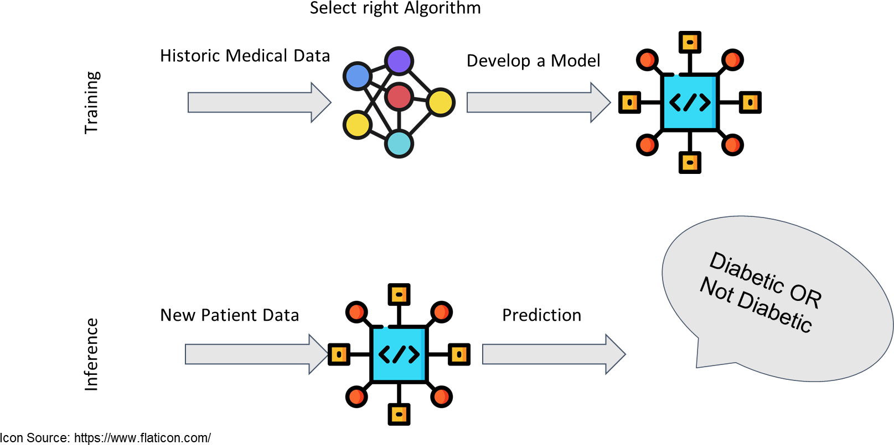
Workflow For Developing DPS

Slide 6

Contents & Structure
ML Terminology
ML Pipeline
Module Code & Module Title
Slide Title
SLIDE 6

Slide 7
ML Terminology
Dataset: A sample of real-world observations, organised
into a table - rows and columns
Feature: a column in the dataset table. Also called a predictor, variable, input, attribute, covariate
Training example: A row in the table representing a set of feature values. Also called an observation, record, training instance
Target: What we want to predict. Also called ground truth, (class) label, desired or expected output, response variable, dependent variable

Slide 8
ML Terminology
Model: A function in the form y = f(x) that we believe (or hope) is similar to the true function that represents the relationship between the target (y) and the observations in the dataset (x). Also called the target function or objective function
Prediction or Output: Outcome from applying the model to the dataset - used to distinguish from targets, which are desired or expected outputs
Classifier: An implementation that combines a Learning algorithm, a Loss function, and an Optimiser to create a model and generate predictions

Slide 9
ML Terminology
Learning algorithm: A set of (mathematical) instructions that create a model using the training dataset. Most classifiers are named for the learning algorithm they implement to find or approximate the target function
Loss function: Measures how far the predicted output for a single training example is from its true value. Also called the error function.
Optimiser: An algorithm used to minimize the average or summed output of the Loss function for the entire dataset (the Cost function)

Slide 10
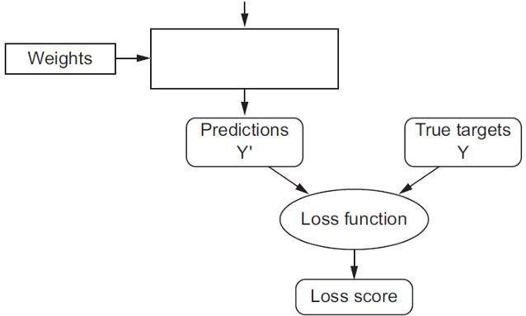
Input Row
 | Da | ta | set
Essentially, the loss function and optimizer work together to fit the algorithm to the data in the best way possible.
Hyper-
Parameters
Loss Function
Optimiser
Behavior
Tuning
Classifier
( algorithms )

Slide 11
ML Terminology
Model Parameters: The parameters that the learning algorithm “learns” from the training data - for example, the slope (weight coefficients) and y-axis intercept of a linear regression line
Fitting a Model: The process of learning the Model
Parameters
Hyperparameters: The tuning parameters of a classifier that affect its behavior, such as error tolerance, number of iterations, or options between variants of how the algorithm behaves. The programmer will specify defaults, and the user can pass new values with the function call.

Slide 12
ML Terminology
Model Evaluation: Model performance is usually evaluated by counting the fraction of correctly classified instances out of all instances that the model attempted to classify.
– For example, if we have a test dataset of 10,000 instances and a model classified 7,000 instances correctly, then we say that the model has a 70% accuracy on that dataset.
Note that optimization and evaluation measures are usually not the same in practice.

Slide 13
ML Terminology
Training/fitting a model typically involves an algorithm that optimizes an objective function (e.g., maximizing the log-likelihood or minimizing mean squared error)
In practice, we are often interested in the accuracy of a model on new, unseen data that has the same distribution as the training data (the generalization performance)
There are a number of different algorithms for model parameter optimization, as well as a number of different techniques for estimating the generalization performance of a model

Slide 14
Supervised Learning
Algorithm
Observations
Model
Classifications
Machine learning (ML) pipeline consists of several steps to train a model.
ML pipeline is iterative: steps are repeated to continuously improve the accuracy of the model

Slide 15
Pipeline of Machine Learning Task
Machine learning (ML) pipelines consist of several steps to train a model.
ML pipelines are iterative as every step is repeated to continuously improve the accuracy of the model and achieve a successful algorithm.
A typical machine learning pipeline:
  Data collection
  Data cleaning
  Feature extraction (labelling and dimensionality reduction)
  Model validation
  Visualisation

Slide 16
Machine Learning Pipeline
What do I have What do I need What can I get
Problem Definition
Data collection
“Objective” in “objective function”
Feature extraction
  Flattening, Labeling
Data preparation
  Normalisation by data type
  Dimensionality reduction
Exploratory Data
Analysis (EDA)
Algorithm Selection
  Train and Test
Performance Evaluation
  Visualisation
Selection of
metrics
May have special data preparation requirements
– Parameter tuning
Model Validation
Repeat Train and Test

Slide 17
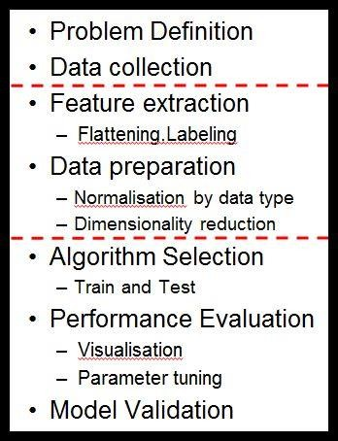
Machine Learning Pipeline
Problem Definition
Goal: Decide what information is needed
Methods: Typically used are committee meetings, brainstorming, and analysis of business objectives
Outcome: A project specification for the Data Scientists.

Slide 18
Machine Learning Pipeline
Data Collection
Goal: Representative sample of the population
Methods: Extract existing data from databases, gather new data
Outcome: A large dataset

Slide 19
Machine Learning Pipeline
Feature Extraction
Goal: Specifying features useful for prediction
Methods: Check distributions, correlation/covariance checks, drop unique identifiers
Outcome: A “flat” (single table) dataset with selected features.

Slide 20
Machine Learning Pipeline
Data Preparation
Goal: Clean up (normalize, regularize) the data values
Methods: Scaling, dummy variables, interpolating missing values
Outcome: Normalized data in numeric form appropriate for modeling

Slide 21
Machine Learning Pipeline
Algorithm Selection
Goal: No a-priori best algorithm; must experiment
Methods: Draw on problem statement, domain knowledge, knowledge of ML and statistical methods, and library help files to choose candidate algorithms
Outcome: A set of algorithms that should be appropriate for the analytical task

Slide 22
Machine Learning Pipeline
Performance Evaluation
Goal: Test candidate algorithms and evaluate predictive accuracy
Methods: Fit each algorithm on the same set of historic training data, analyse confusion matrix and various other metrics
Outcome: Comparison of results from selected algorithms

Slide 23
Machine Learning Pipeline
Model Validation
Goal: Evaluate robustness of the predictive model, check for over-fitting, refine hyperparameters
Methods: Grid search CV, k-fold CV
Outcome: Optimization of the objective function, good generalisation performance

Slide 24
Machine Learning Pipeline
Iteration:
Algorithm Selection
Certain algorithms may be selected because they return a measure of feature importance which can be fed back to the feature extraction phase

Slide 25
Machine Learning Pipeline
Iteration:
Model Validation
The model validation phase should lead to a new round of performance evaluation, and the set of candidate algorithms will gradually be reduced until one algorithm (or one ensemble of algorithms) is selected.

Slide 26
Further Reading
What is a Machine Learning Pipeline?
https://youtu.be/HWWxtVL-D9k
The 7 Steps of Machine Learning https://youtu.be/nKW8Ndu7Mjw

Slide 27
Review Questions
What are the different terminology in Machine Learning?
What are the key steps (pipeline) in Machine Learning?
Module Code & Module Title
Slide Title
SLIDE 27

Slide 28
Summary / Recap of Main Points
Various terminologies in Machine Learning.
Various steps in the Machine Learning pipeline.
Module Code & Module Title
Slide Title
SLIDE 28

